Slide 1
LASER SECURITY SYSTEM
GROUP MEMBERS:
M.SAI KIRAN KUMAR (2451-16-737-046)
G.VAMSHI KRISHNA(2451-16-737-060)
D.SAI PRANAV (2451-16-737-054)
GUIDE-DBV RAVISANKAR
(Associative professor)

Slide 2
ABSTRACT
The issue of security is very important in any organization, especially in museum, banks.
To protect the historical objects in museum, cash in banks, lockers, homes etc, we have design a laser security system that involves a laser light surrounded by the object and alarm or buzzer is connected.
Whenever an opaque thing is brought in between the laser light, huge sound is generated in buzzer. With this mechanism, one can be safe in protecting their objects in museum and in banks.
Here the main components of Laser security system are LDR and a basic alarm unit.
These are easy to install and work at both within as well as outside houses.

Slide 3
SCOPE OF WORK
In this project, we have designed a simple DIY laser based security system, which acts as a tripwire like security system and triggers an alarm when the laser is interrupted.
The design of the laser security system circuit is very simple. We will see the design of the circuit in this section and in the working explanation we will see the working of the individual component.
Coming to the design of the circuit, first, the LDR and a 10 K Ω resistor are connected in a voltage divider fashion and its output (common point) is connected to the pin 3 (non – inverting) of the Op- Amp IC LM358.
LM358IC output is connected to BC547 transistor and NE555 for triggering purpose.

Slide 4
I N T R O D U C T I O N
Security is the most important factor today. Technology develops day by day in the world.
In this project,we have designed a cheap and effective laser security system.
By using this security alliances we can protect banks and houses.
We know that laser light goes through a long distance without any scattering affect. This is one of the major advantage of using laser light in this project.

Slide 5
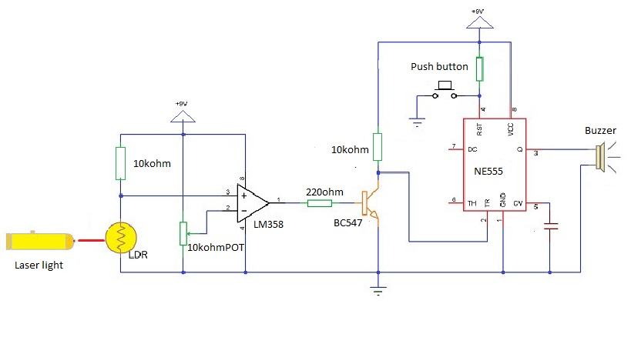
CIRCUIT DIAGRAM

Slide 6
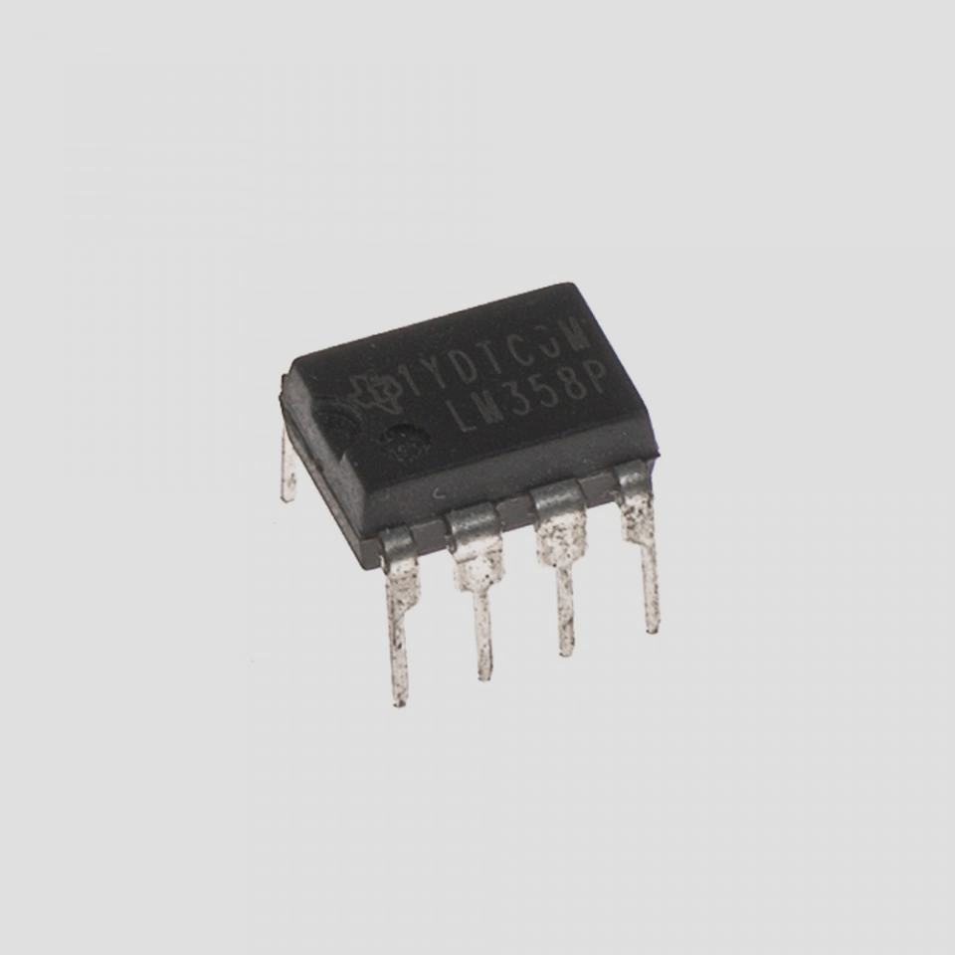
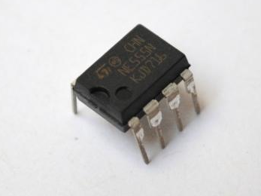
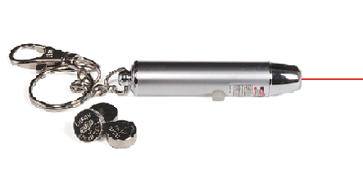
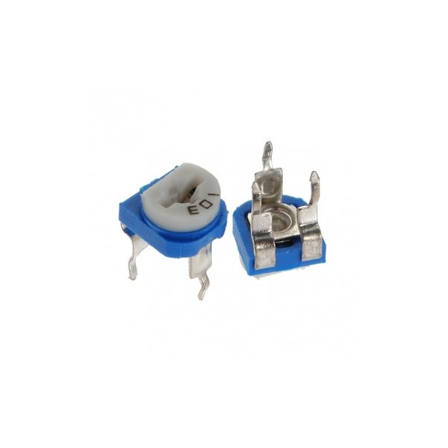
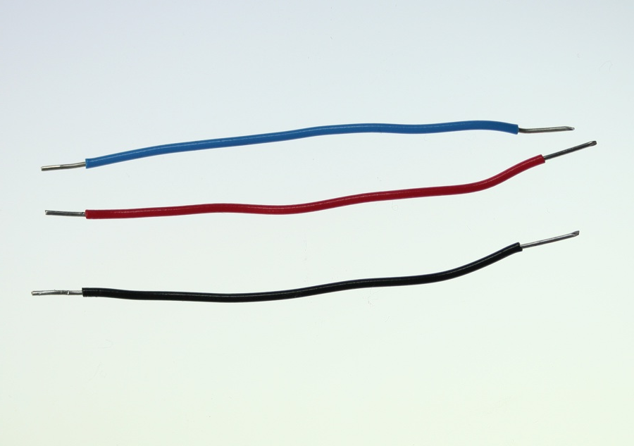
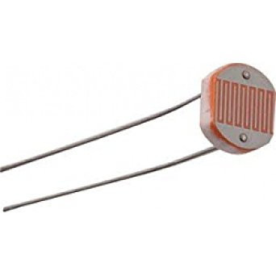
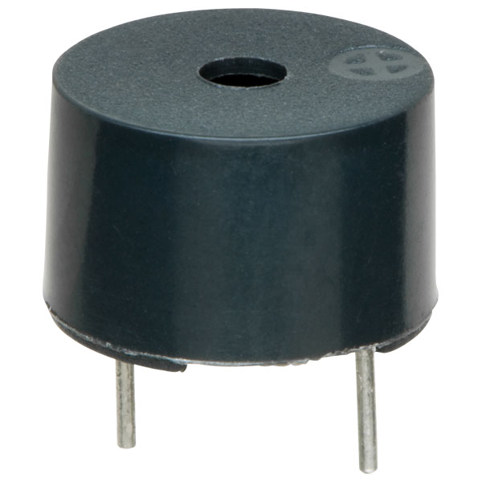
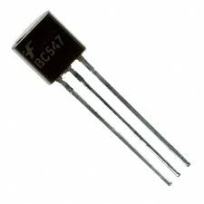
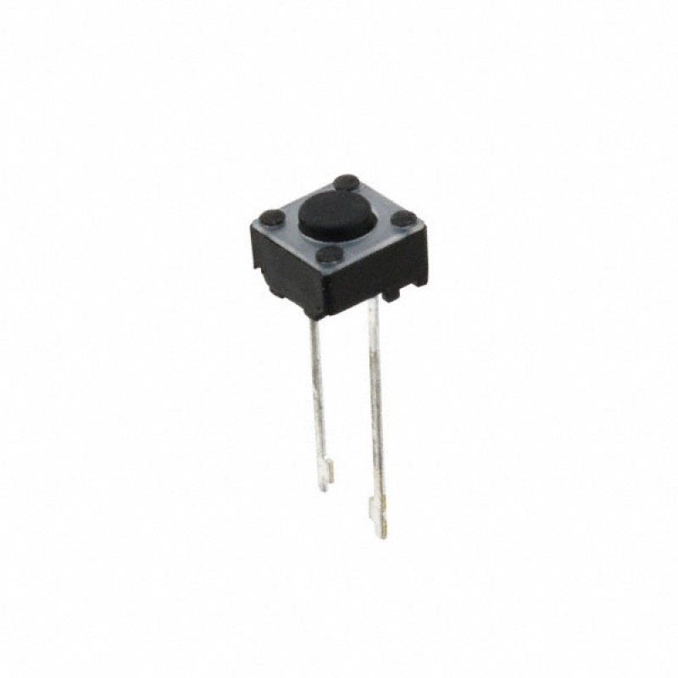
COMPONENTS USED
LM358
NE555
Laser Pointer Potentiometer
Connecting wires LDR Buzzer BC547 Push Button

Slide 7
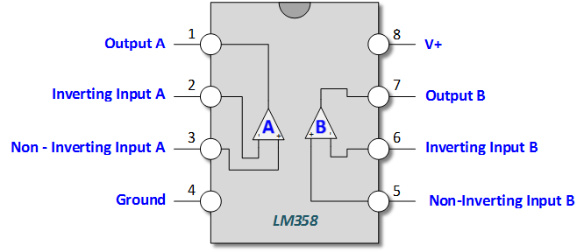
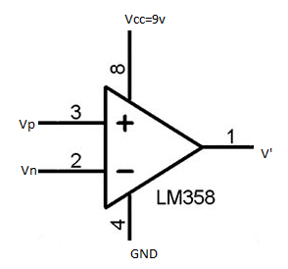
LM358-IC:-The LM358 IC is a great, low power and easy to use dual channel op-amp IC. It consists of two internally frequency compensated, high gain, independent op-amps.
This IC is designed for specially to operate from a single power supply over a wide range of voltages. The LM358 IC is available in a chip sized package

Slide 8
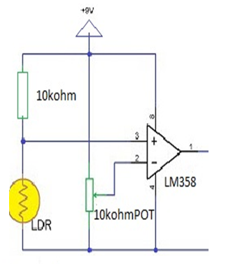
In our circuit ,op-amp act as a comparator.
It compares the voltages at the inverting and non – inverting terminals and produces an output accordingly.
Then we can see that the op-amp voltage comparator is a device whose output is dependant on the value of the input voltage, V_{IN} with respect to some DC voltage level as the output is HIGH when the voltage on the non-inverting input is greater than the voltage on the inverting input, and LOW when the non-inverting input is less than the inverting input voltage.

Slide 9
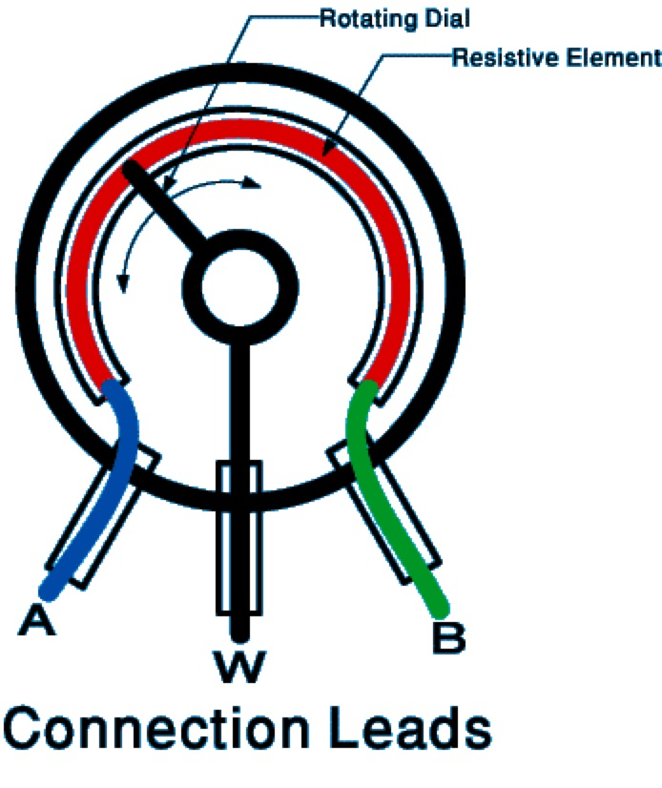
POTENTIOMETER:-A potentiometer is a three-terminal resistor with a sliding or rotating contact that forms an adjustable voltage divider. If only two terminals are used, one end and the wiper, it acts as a variable resistor or rheostat.
We know that basic op-amp comparator produces negative and positive voltages .
Accordingly, we need to vary the voltage. Thus we use potentiometer, a resistive voltage divider is used to set the input reference voltage of a comparator

Slide 10
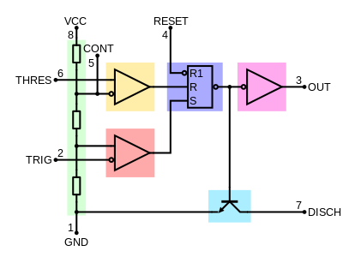
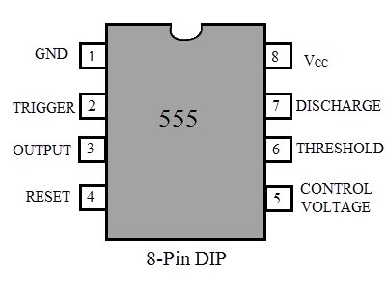
NE555:IC555 is a precision timing IC that provides time delays or oscillations.
555 timer IC has three modes of operation: a stable, monostable and
bi-stable. In this project, we are going to use the IC 555 in bi-stable mode.
The 555 timer IC is an integrated circuit (chip) used in a variety of timer, pulse generation, and oscillator applications. The 555 can be used to provide time delays, as an oscillator, and as a flip-flop element. Derivatives provide two (556) or four (558) timing circuits in one package.

Slide 11
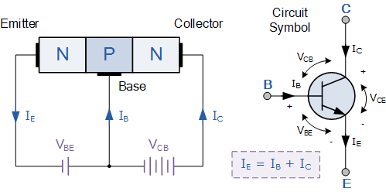
NPN is one of the two types of bipolar transistors, consisting of a layer of P-doped semiconductor (the "base") between two N-doped layers. A small current entering the base is amplified to produce a large collector and emitter current.

Slide 12
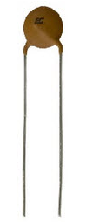
LASER POINTER:-Laser pointer acts as the main source of light in this project. We have used a small laser pointer with an output power of less than 1mW. The laser pointer emits red light and the wavelength of the laser out put is between 630 nm to 680nm
Capacitor: is an electronic component that stores electric charge. The capacitor is made of 2 close conductors (usually plates) that are separated by a dielectric material. The plates accumulate electric charge when connected to power source.
LIGHT DEPENDENT RESISTOR(LDR) :-The LDR acts as a light sensor in this project. As the intensity of the light falling on the LDR increases, the resistance of the LDR decreases and vice-versa. The LDR is used in combination with the laser to form the light sensor and source

Slide 13
WORKING OF THE PROJECT
A simple and cheap, effective laser security system is developed. Let us see the working of the project:
LDR has low resistance in the presence of light and high resistance in the absence of light.
The voltage drop across the LDR is used to switch on the transistor.
In our security alarm a laser light is allowed to fall on the LDR continuously.
The circuit, construction and setup for the Laser Security System is very simple.

Slide 14
First, the Op – Amp circuit acts as a comparator i.e. it compares the voltages at the inverting and non – inverting terminals and produces an output accordingly.
The LDR – 10 KΩ resistor Voltage divider is connected to the non – inverting terminal of Op –Amp and a POT is connected to the inverting terminal.
Assume, the laser pointer is placed directly in line of sight to the LDR and the light from the laser is continuously being incident on LDR.
In this situation, the resistance of LDR falls down to few Ohms (or tens of Ohms) and as a result, the voltage at the non – inverting terminal will be less than that at the inverting voltage. The output of the Op –Amp is low and the transistor is OFF.

Slide 15
If the laser light is blocked by an intruder from falling on the LDR (even for a small duration), the resistance of the LDR goes to few hundreds of Ohms and as a result, the output of the Op –Amp will be HIGH. This will turn on the Transistor.
As the output of the transistor is connected to the Trigger Pin (Pin 2) of the 555 Timer IC, if the transistor is ON, the trigger pin gets a short low pulse and as a result, the output of the 555 becomes HIGH. This will activate the alarm by turning ON the buzzer.
Since, the 555 Timer IC is configured as a Bi – Stable Multivibrator, a small active low trigger pulse at the trigger pin will set its output to HIGH and in order to reset it we need to push the reset button.
Until the reset push button is pushed, the alarm will stay on hence, we can place the reset button at a secret location so that only the owner can disable the alarm.

Slide 16
ADVANTAGES:
The circuit, construction and setup for the Laser Security System is very simple.
If used with a battery, the laser security system can work even when there is a power outage.
DISADVANTAGES:
In order to secure a larger area, we need more lasers and corresponding sensors.

Slide 17
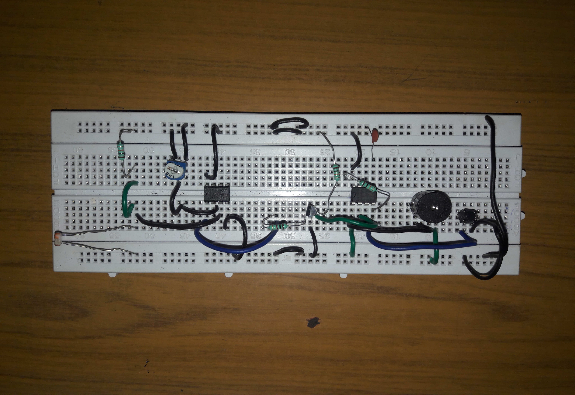
CIRCUIT CONSTRUCTION

Slide 18
CONCLUSION
1.Laser Security System can be used in safety lockers in our homes, where even if the locker’s code is hacked, it acts as an additional layer of security.
2.Apart from security systems, this laser based setup can also be used to check if pets or babies crossed a certain boundary.
3. Use of plane mirrors at correct inclination to the object. We can cover large space to protect it.
4. If used with a battery, the laser security system can work even when there is a power outage.

Slide 19
ANY QUERIES???

Slide 20
THANK
YOU

